Slide 1
MULE SOFT DEBUG PROGRAM
PRESENTED BY : HARSHADA AMBALKAR

Slide 2
Topics
Mule Project Creation
Basic Structure
Smiple Program
Run Program

Slide 3

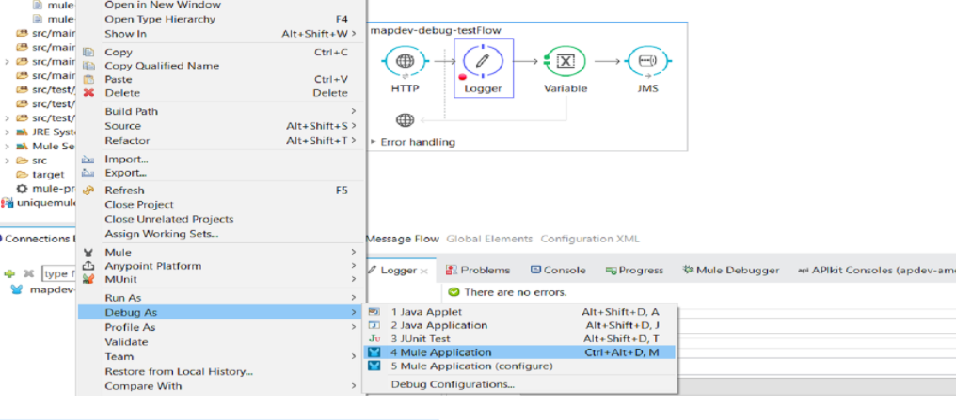
Run Program in Debug
We will continue with the program mentioned in previous session . Run the program in debug mode

Slide 4
Debug Mode Continues
Mule application will be running in ‘Mule debug’ perspective
Mule Debugger perspective
Will open and application would start running in deubug mode . Upon successful deployment , debugger view will open

Slide 5
Some Debugging Issues
There could be some sceniores where application might not run in debug mode. Anypoint doesn’t show the error sometime in that case
- possible solution
>change the port number for debug mode
> Restart the workspace
Port number can be changed by going into below
Right click>Debug>Debug Configrutions >Mule Debugger >port

Slide 6
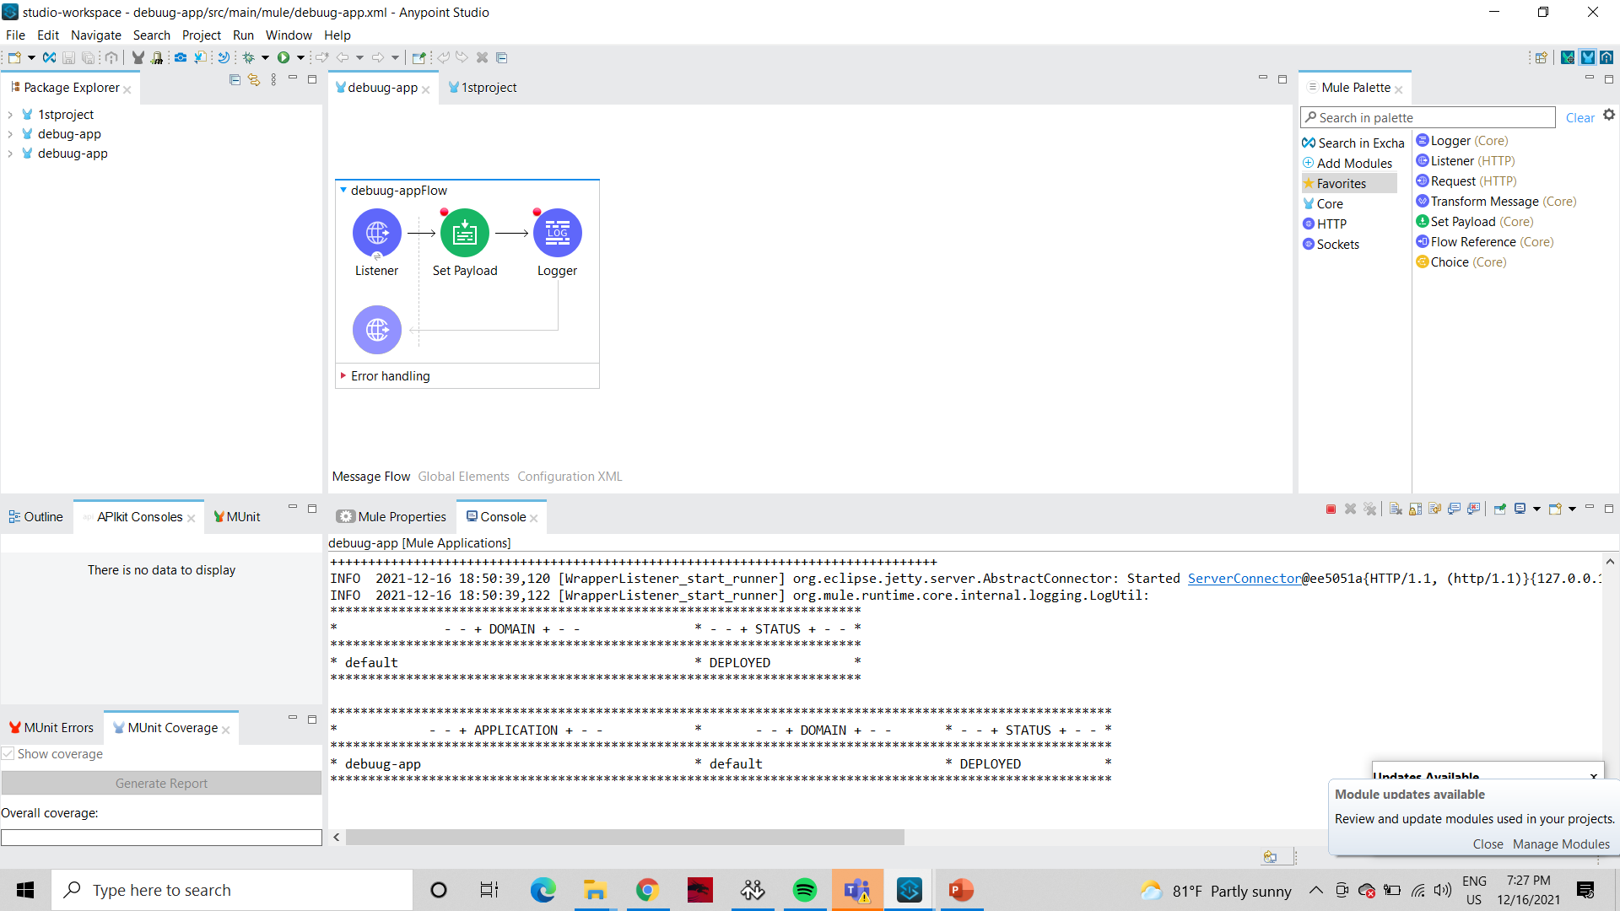
Apply Breakpoint
Breakpoint can be applied easily by right click on any of the message

Slide 7
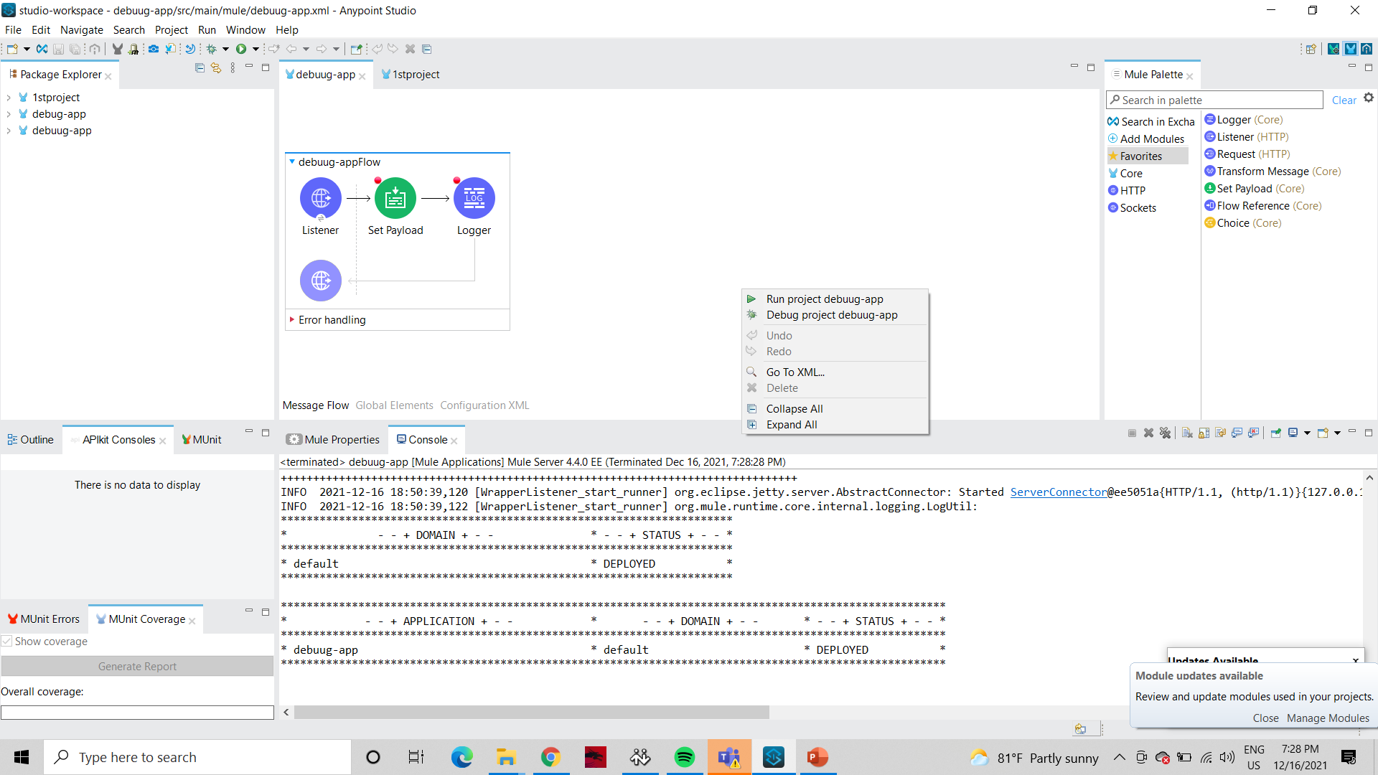
Debug Program

Slide 8
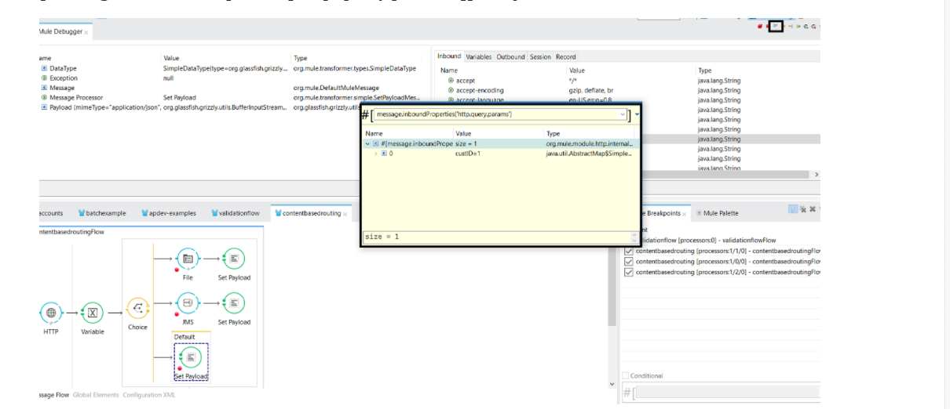
Debug Program (Continue)

Slide 9
Debug Program
Progarm can be continue . By pressing f8 or next message processer button under mule debugger
Debugger is having capabilities to check the properties at runtime evalute the expression analyze each component in detail

